Slide 1

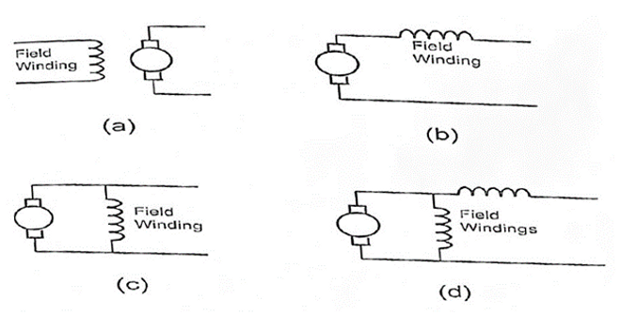
7.1. Types of DC Motor Connections and Their Characteristics
Notes:
Let’s go through the four types of DC motor connections shown on the diagram

Slide 2
7.1. Types of DC Motor Connections and Their Characteristics
Series DC Motor
Notes:
Diagram (a) shows a Series DC Motor. In this motor, the field winding is in series with the armature. That means the same current flows through both. This setup gives us very high starting torque, making it ideal for heavy-duty startup applications like cranes. But it’s important to remember that the speed is not constant and can be dangerous if the motor runs without load.

Slide 3
7.1. Types of DC Motor Connections and Their Characteristics
Series DC Motor
Shunt DC Motor
Notes:
Diagram (b) is a Shunt DC Motor. Here, the field winding is connected in parallel with the armature. This motor maintains a constant speed, regardless of load changes, making it great for applications like conveyors and machine tools.

Slide 4
7.1. Types of DC Motor Connections and Their Characteristics
Series DC Motor
Shunt DC Motor
Cumulative Compound DC Motor
Notes:
Diagram (c) shows a Cumulative Compound DC Motor. It combines both series and shunt windings. The magnetic effects of both windings support each other, so we get a balance between torque and speed regulation. It’s commonly used in presses and elevators.

Slide 5
7.1. Types of DC Motor Connections and Their Characteristics
Series DC Motor
Shunt DC Motor
Cumulative Compound DC Motor
Differential Compound DC Motor
Notes:
Finally, diagram (d) represents a Differential Compound DC Motor. Like the cumulative type, it has both series and shunt windings—but here, the windings oppose each other magnetically. This results in a motor that is very stable under light loads but has poor torque response, so it’s not commonly used.

Slide 6
7.1. Types of DC Motor Connections and Their Characteristics
Series DC Motor
Shunt DC Motor
Cumulative Compound DC Motor
Differential Compound DC Motor
Notes:
Each configuration has its own unique performance characteristics and is chosen based on the demands of the application.

